Slide 1
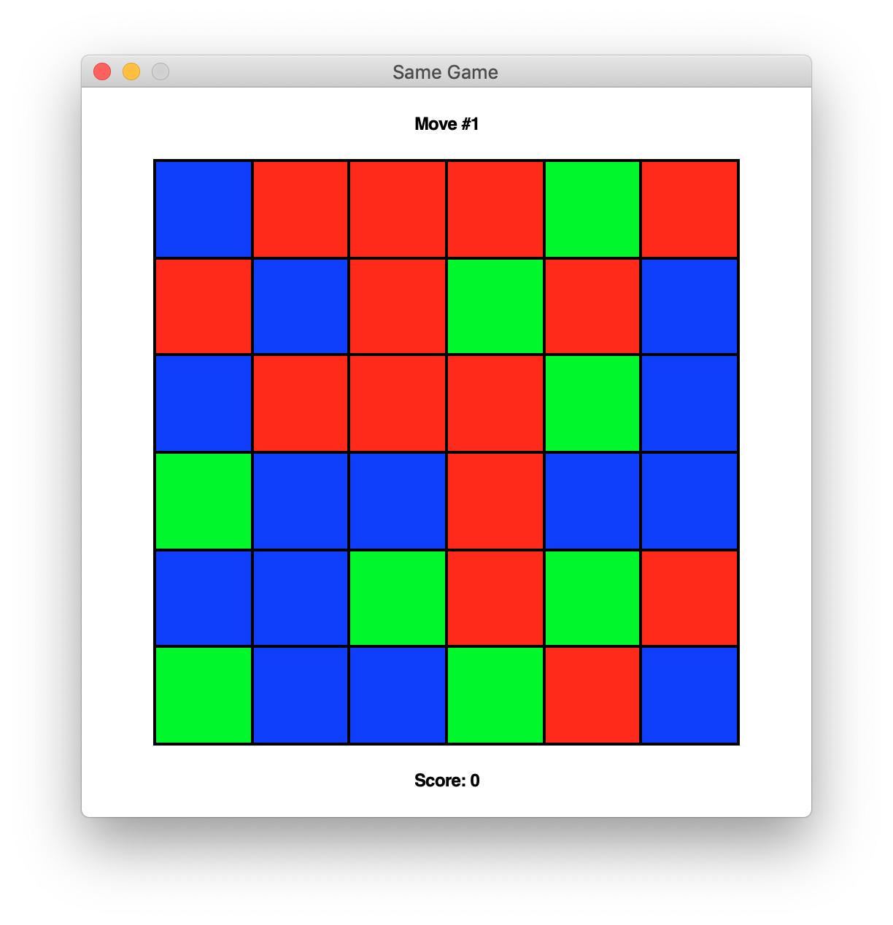
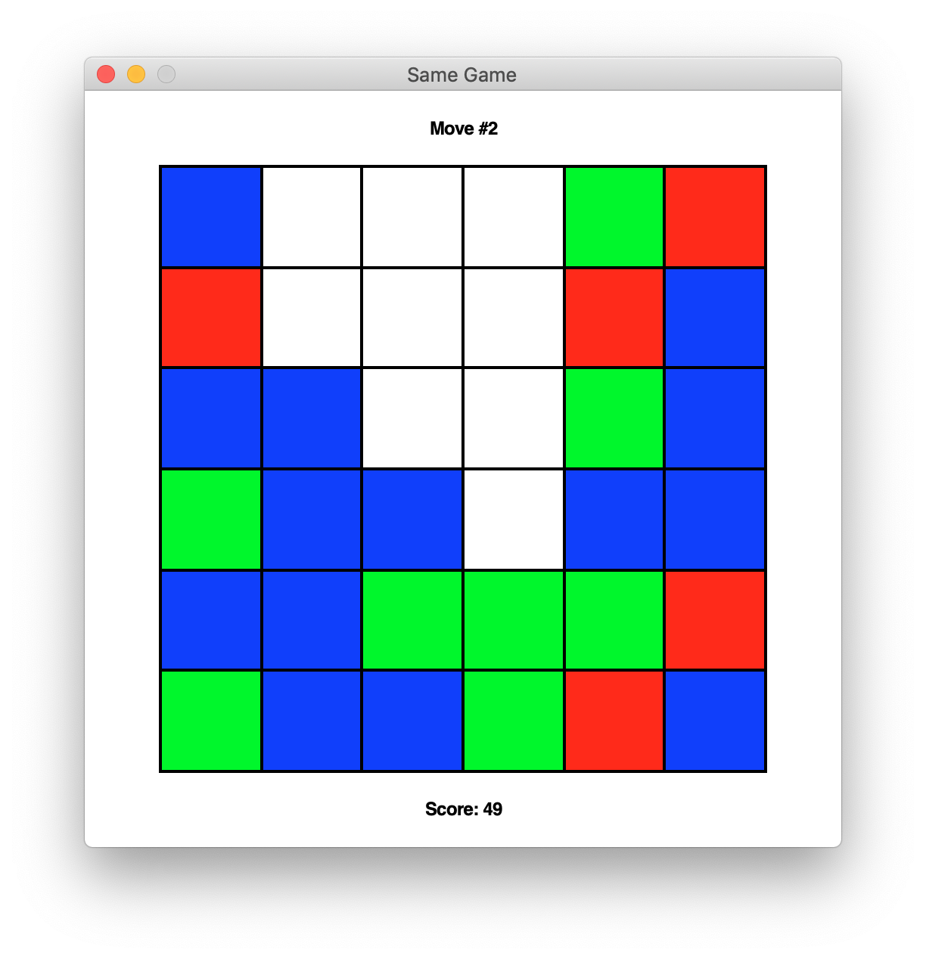
The Same Game

Slide 2
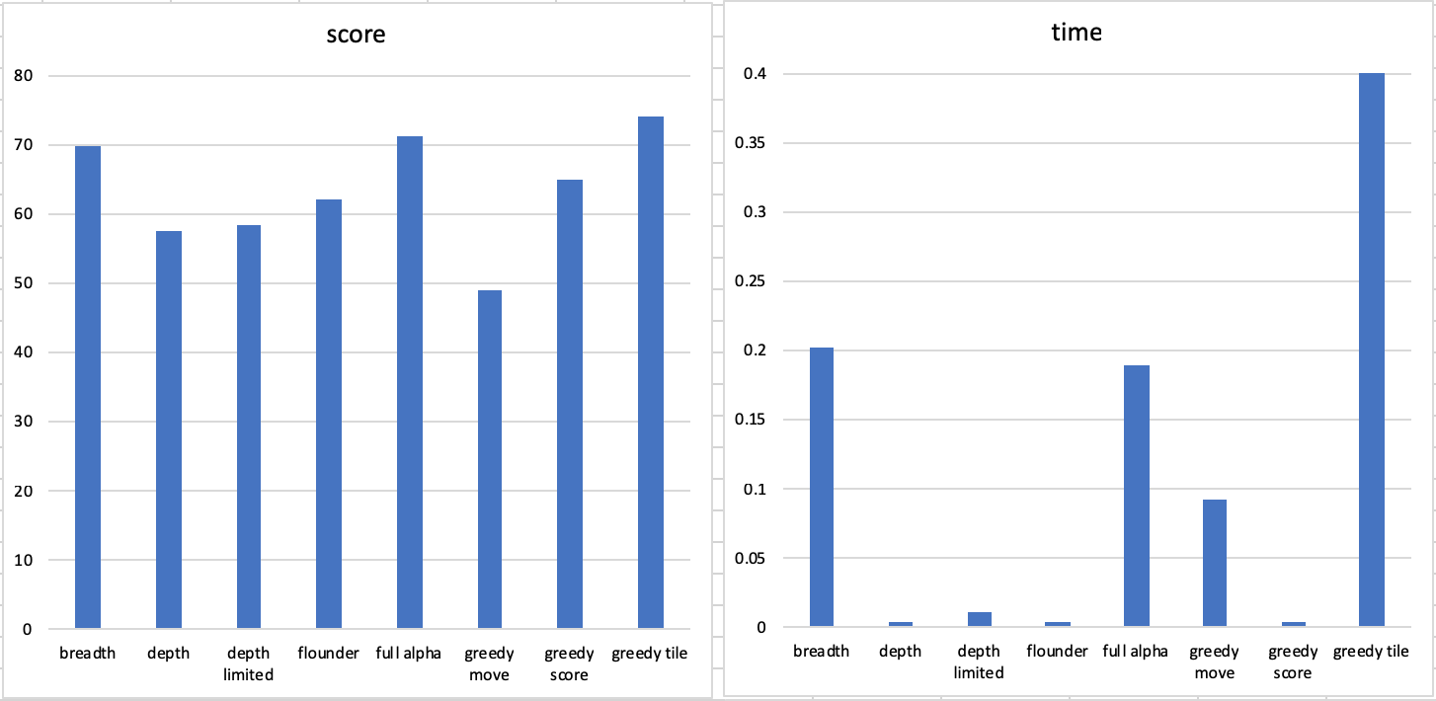
The Same Game
Metrics:

Slide 3
The Same Game
Time Complexity:
4x4 --> 8! = 40,320
5x5 --> 13! = 6,227,020,800
6x6 --> 18! = 6,402,400,000,000,000

